Slide 1
NEURAL NETWORKS

Slide 2
LEARNING OBJECTIVES
PROGRESSING IN YOUR DATA SCIENCE CAREER
Understand various types of neural networks
Applications of neural networks
Apply a neural network model for regression
Apply a neural network model for classification
Understand the concepts behind perceptrons and hidden layers
Understand back propagation

Slide 3
COURSE
PRE-WORK

Slide 4
PRE-WORK REVIEW
Understand Logistic Regression and link functions
Be familiar with training and testing classifiers and regressors

Slide 5
OPENING
ARTIFICIAL NEURAL NETWORKS

Slide 6
OPENING
Neural networks were first studied in the 1940s (!) as a model of biological neural networks
Many advances since then have improved the ability to train and apply neural networks
Good for both classification and regression but difficult to interpret model behaviors
Deep learning in the past few years has been highly successful for otherwise difficult problems

Slide 7
OPENING
Today we will focus on types of neural networks and their applications, and skip some of the more technical details
Specifically we’ll skip training neural networks -- there are many methods in various situations and the details can be tedious (but not particularly difficult)
Methods include backpropagation, gradient descent, and Hessian-free learning

Slide 8
INTRODUCTION
HISTORY

Slide 9
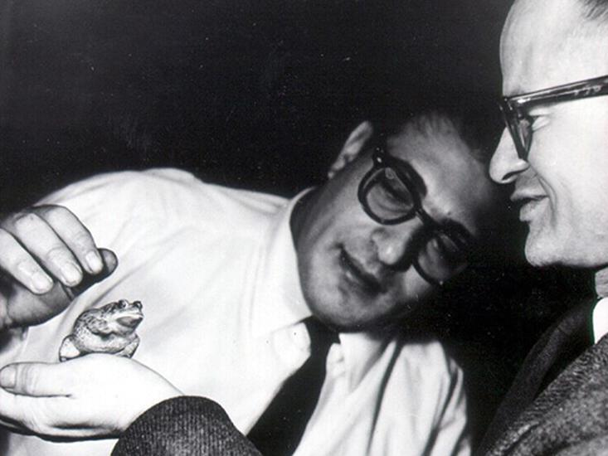
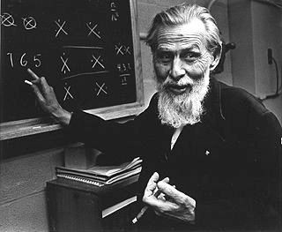
NEURAL NETWORKS
McCulloch was a confident, gray-eyed, wild-bearded, chain-smoking philosopher-poet who lived on whiskey and ice cream and never went to bed before 4 a.m.
At the age of 12, after reading Principia Mathematica he sent a letter to Bertrand Russell pointing out what he considered serious problems with the first half of the first volume
Walter Pitts
Warren McCulloch
Proposed that all of mathematics could be built from the ground up using basic logic. Their building block was the proposition – the simplest possible statement, either true or false.
From there, they employed the fundamental operations of logic, like ‘and’, ‘or’, and ‘not’
http://nautil.us/issue/21/information/the-man-who-tried-to-redeem-the-world-with-logic

Slide 10
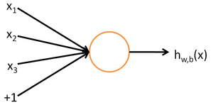
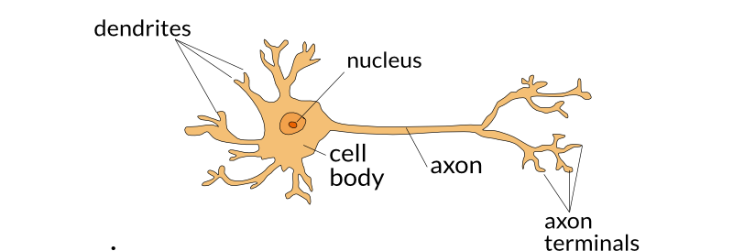
NEURAL NETWORKS
Neurons – They act like a ‘true’ or ‘false’?
They only fire after a minimum threshold has been reached
A neuron’s signal is a proposition and they work like logic gates where they take in multiple inputs and produce a single output
http://nautil.us/issue/21/information/the-man-who-tried-to-redeem-the-world-with-logic

Slide 11
NEURAL NETWORKS
Example: Where will you go out for lunch?
What are some of the inputs to making that decision?
You will make a decision if and only if enough criteria are satisfied
http://nautil.us/issue/21/information/the-man-who-tried-to-redeem-the-world-with-logic

Slide 12
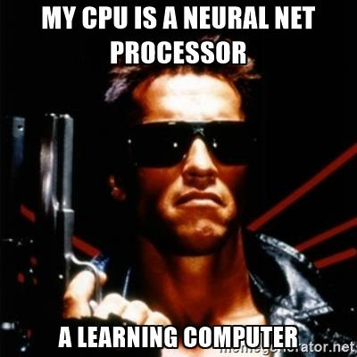
NEURAL NETWORKS
McCulloch became convinced that the brain was just such a machine – one which uses logic encoded in neural networks to compute
Neurons could be linked together by the rules of logic to build more complex chains of thought
http://nautil.us/issue/21/information/the-man-who-tried-to-redeem-the-world-with-logic

Slide 13
INTRODUCTION
NEURAL NETWORKS

Slide 14
NEURAL NETWORKS
A Neural Network is a highly interconnected network of information-processing elements that mimics the connectivity and functioning of the human brain.
Supervised and Unsupervised learning algorithm
Advances in computer processing power and storage (database) are finally allowing neural nets to improve solutions for complex problems such as speech recognition, computer vision, and Natural Language Processing (NLP)
We will go over how its used in classification

Slide 15
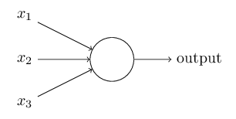
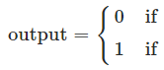
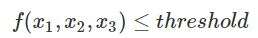
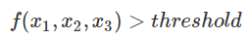
NEURAL NETWORKS
To mimic the behavior of neurons, we use something called a perceptron – they take several inputs (x1, x2, …) and produce a single binary output
Think of perceptrons as a method for weighing evidence to make decisions
Decision Function
Input Variables
http://neuralnetworksanddeeplearning.com/chap1.html

Slide 16
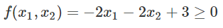
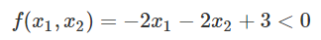
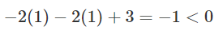
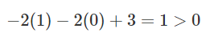
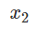
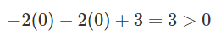
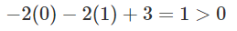
NEURAL NETWORKS
Example: let’s say we have two input variables and the output is based on the following function:
Suppose x1 and x2 are binary. Let’s look at the different possible outputs:
x1 = 1, x2 = 1
x1 = 1, x2 = 0
x1 = 0, x2 = 0
x1 = 0, x2 = 1
Output = ?
Output
Output = ?
Output = ?
Output = ?

Slide 17
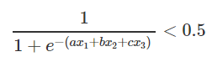
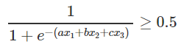
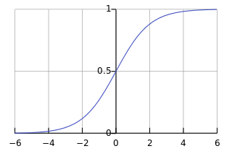
NEURAL NETWORKS
Another example of a neural network with one perceptron is a Logistic Regression
The decision function is based on the sigmoid function where the output is bounded between 0 and 1.
The linear combination of coefficients with input values gives you one decision boundary.

Slide 18

NEURAL NETWORKS
Our brains have many neurons. Therefore, we can also have many perceptrons in a neural network.
We can also have several layers of perceptrons - we call them hidden layers
We choose both the # of layers and # of perceptrons in each layer.
In this example, the perceptrons in the hidden layer are making four decisions based on the input variables.
Hidden layers have binary values
http://neuralnetworksanddeeplearning.com/chap1.html

Slide 19
KNOWLEDGE CHECK
What is a neural network supposed to mimic?
What is a perceptron? How does it make decisions?
What is an example of a neural network with just one perceptron?

Slide 20
INTRODUCTION
EXAMPLE

Slide 21
NEURAL NETWORKS
Example
Suppose you want to use a neural network to classify whether a point is a circle or square with two features, x1 and x2.
X2
How would a neural network fit this data?
X1

Slide 22
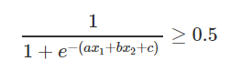
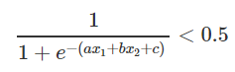
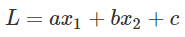
NEURAL NETWORKS
Example
The points could be separated with one decision boundary AKA one perceptron
This decision boundary could be derived using Logistic Regression
X2
Output
Square if
Output =
Circle if
X1
The decision boundary is derived the same way as in Logistic Regression using Gradient Descent

Slide 23
NEURAL NETWORKS
How does a neural network come up with the decision boundary?
X2
X1

Slide 24
INTRODUCTION
BACK PROPAGATION

Slide 25
BACK PROPAGATION
What is it? The process in which we determine our decision boundaries for classification
We use the same process for finding the decision boundary in Logistic Regression.
How does it work?
A set of training examples is given: {(x, d)*} where x is the input and d the target output [supervised learning]
2. Examples are presented to the network.
For each example, the network gives an output y.
If there is an error, the decision boundary/line is moved in order to correct the output error.
We adjust the boundary using Gradient Descent
When the error has reached a minimum threshold, Stop learning.

Slide 26
INTRODUCTION
GRADIENT DESCENT
REFRESHER

Slide 27
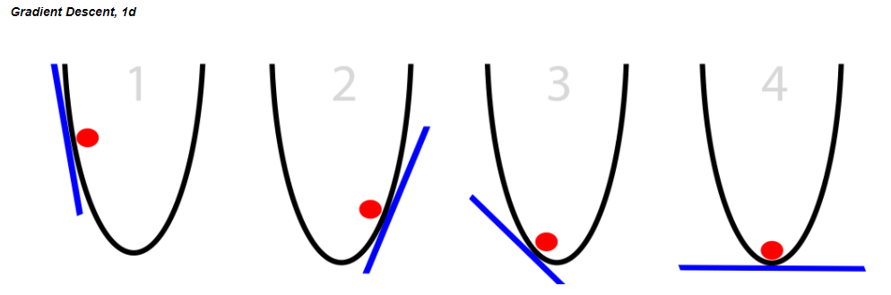
GRADIENT DESCENT
Gradient Descent is an iterative process that we use to pick our decision boundary
You can see it as almost a guess and check – do these sets of coefficients minimize the error between my guess and the true point? If no, then keep looking for better coefficients. If yes, then stop!
The y-axis represents the residuals AKA the cost function, and the x-axis represents our parameters for the decision boundary
Notice how there is only one point that minimizes the cost function

Slide 28
GRADIENT DESCENT
A random linear solution is provided as a starting point (usually a "flat" line or solution)
The solver then attempts to find a next step: we take a step in any direction and measure each performance.
If the solver finds a better solution (optimizing toward a metric such as mean squared error), this is the new starting point.
Repeat these steps until the performance is optimized and no "next steps" perform better. The size of the steps will shrink over time.
Because we’ve minimized the residuals at this point, the set of parameters we use to define our decision boundary are here!

Slide 29
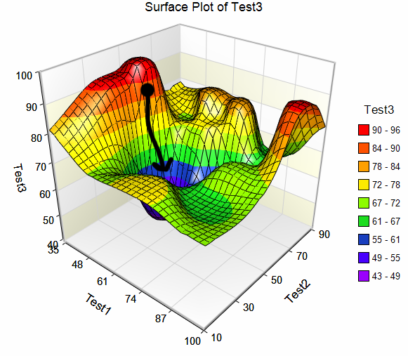
GRADIENT DESCENT
Neural Nets (with at least one hidden layer) may have many solutions for the cost function
Set your iterations as high as you can (without breaking your computer) to converge to the global minimum
Local minimum
Local minimum
Local minimum
Global Optimum

Slide 30
INTRODUCTION
BACK PROPAGATION WALKTHROUGH

Slide 31
BACK PROPAGATION
Consider the following example: (two classes: Red and Green)
How can we find a decision boundary to separate them?
x₂
x₁
d
x₁
W₁=?
y
W₂=?
Σ
x₂
W₀ = ?
X₀=1

Slide 32
BACK PROPAGATION
Random Initialization of perceptron weights
Calculate your error and use gradient descent to figure out how to adjust your line (aka adjust the weights) in order to decrease the error
x₂
x₁
d
x₁
W₁=?
y
W₂=?
Σ
x₂
W₀ = ?
X₀=1

Slide 33
BACK PROPAGATION
Calculate error of new line
Using Gradient Descent, adjust the line towards where the error is decreasing
x₂
x₁
d
x₁
W₁=?
y
W₂=?
Σ
x₂
W₀ = ?
X₀=1

Slide 34
BACK PROPAGATION
Using Gradient Descent, move the line towards where the error is decreasing
x₂
x₁
d
x₁
W₁=?
y
W₂=?
Σ
x₂
W₀ = ?
X₀=1

Slide 35
BACK PROPAGATION
Apply Iteratively Perceptron Training Rule on the different examples:
x₂
x₁
d
x₁
W₁=?
y
W₂=?
Σ
x₂
W₀ = ?
X₀=1

Slide 36
BACK PROPAGATION
Apply Iteratively Perceptron Training Rule on the different examples:
x₂
x₁
d
x₁
W₁=?
y
W₂=?
Σ
x₂
W₀ = ?
X₀=1

Slide 37
BACK PROPAGATION
All examples are correctly classified … stop Learning
x₂
x₁
d
x₁
W₁=?
y
W₂=?
Σ
x₂
W₀ = ?
X₀=1

Slide 38
BACK PROPAGATION
The straight line w₁x+ w₂y + w₀=0 separates the two classes
x₂
W₁x₁ + W₂x₂ +W₀ = 0
x₁
d
x₁
W₁=?
y
W₂=?
Σ
x₂
W₀ = ?
X₀=1

Slide 39
INTRODUCTION
EXAMPLE WITH HIDDEN LAYER

Slide 40
NEURAL NETWORKS
Example
Now suppose we have this data set. How would a neural network fit this data?
X2
X1

Slide 41
NEURAL NETWORKS
Example
We could try using two decision boundaries
X2
We want a decision function that says…
“If it’s between L1 and L2, then it’s a square. Else, it’s a circle”
Or, “If it’s greater than L2 OR less than L1, then it’s a circle. Else, it’s a square”
Can Neural Nets do this?
X1
L1
L2

Slide 42
NEURAL NETWORKS
A Neural Network with two decision boundaries uses two perceptrons: L1 and L2.
Using back propagation it separates the two classes best with these lines
X2
Perceptron
1
(L1)
Output
Perceptron
2
(L2)
X1
L1
L2

Slide 43
NEURAL NETWORKS
We can define the final output by looking at the results of each of our decision boundaries
Perceptron
1
(L1)
Output
X2
Perceptron
2
(L2)
Perceptron 1 value | Perceptron 2 value | Final Output Value
0 = not circle | 0 = not circle | 0 = Square
0 = not circle | 1 = circle | 1 = Circle
1 = circle | 0 = not circle | 1 = Circle
1 = circle | 1 = circle | 1 = Circle
X1
L1
L2

Slide 44
NEURAL NETWORKS
Developing a decision boundary in the hidden layer looks something like this
Perceptron 1 value | Perceptron 2 value | Final Output value
0 | 0 | 1
0 | 1 | 0
1 | 0 | 0
1 | 1 | 0
Perceptron
1
Perceptron
1
(L1)
Output
(L3)
Perceptron
2
(L2)
Perceptron
2
L3

Slide 45
INTRODUCTION
HIDDEN LAYERS: INTUITION

Slide 46
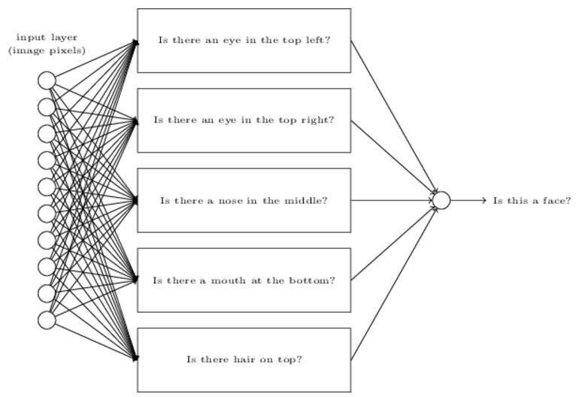

NEURAL NETWORKS
A Deep Net is a neural network that simply has two or more hidden layers
What are the hidden layers doing? => Breaking down the problem into sub-problems
End result is a network that breaks down a complex question into very simple questions
Input data
http://neuralnetworksanddeeplearning.com/chap1.html

Slide 47

NEURAL NETWORKS
Hidden layers extract different layers of patterns.
Each hidden layer gets more detailed and specific about the patterns
Feature representation
3rd layer
“Objects”
Input data
2nd layer
“Object parts”
1st layer
“Edges”
Pixels
[Lee et al., ICML’09]

Slide 48
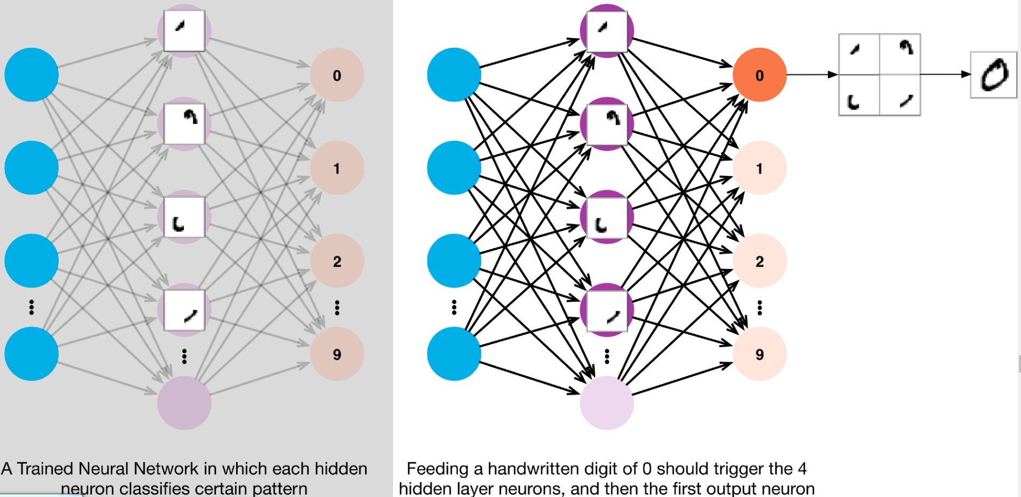
NEURAL NETWORKS
In the case of identifying handwritten digits using a neural network, you can look at the hidden layers recognizing patterns in the digits:

Slide 49
INTRODUCTION
PERCEPTRON

Slide 50
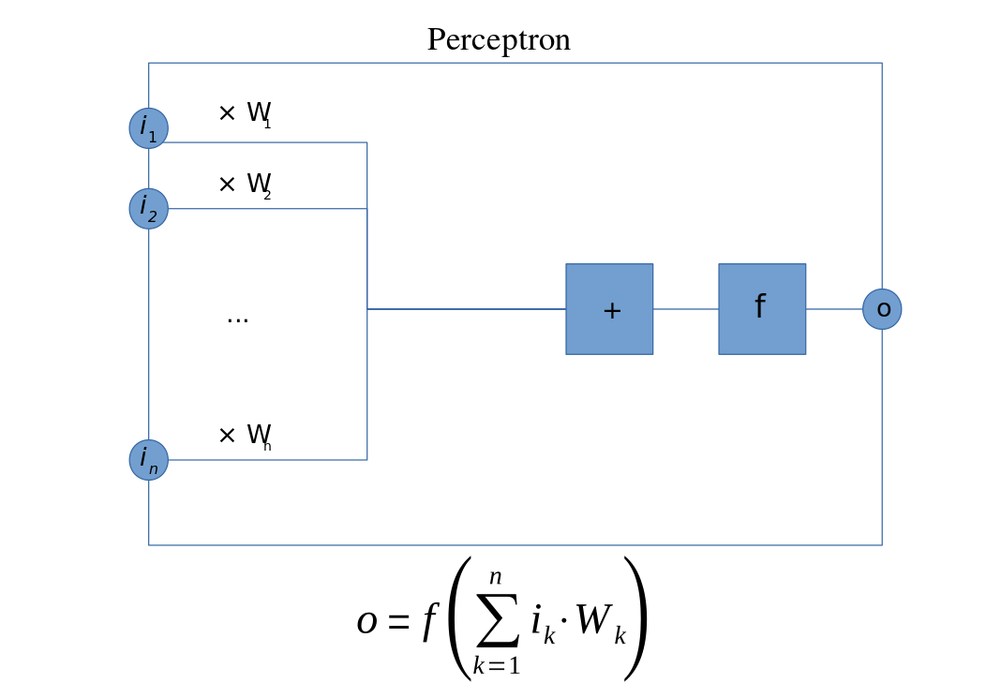
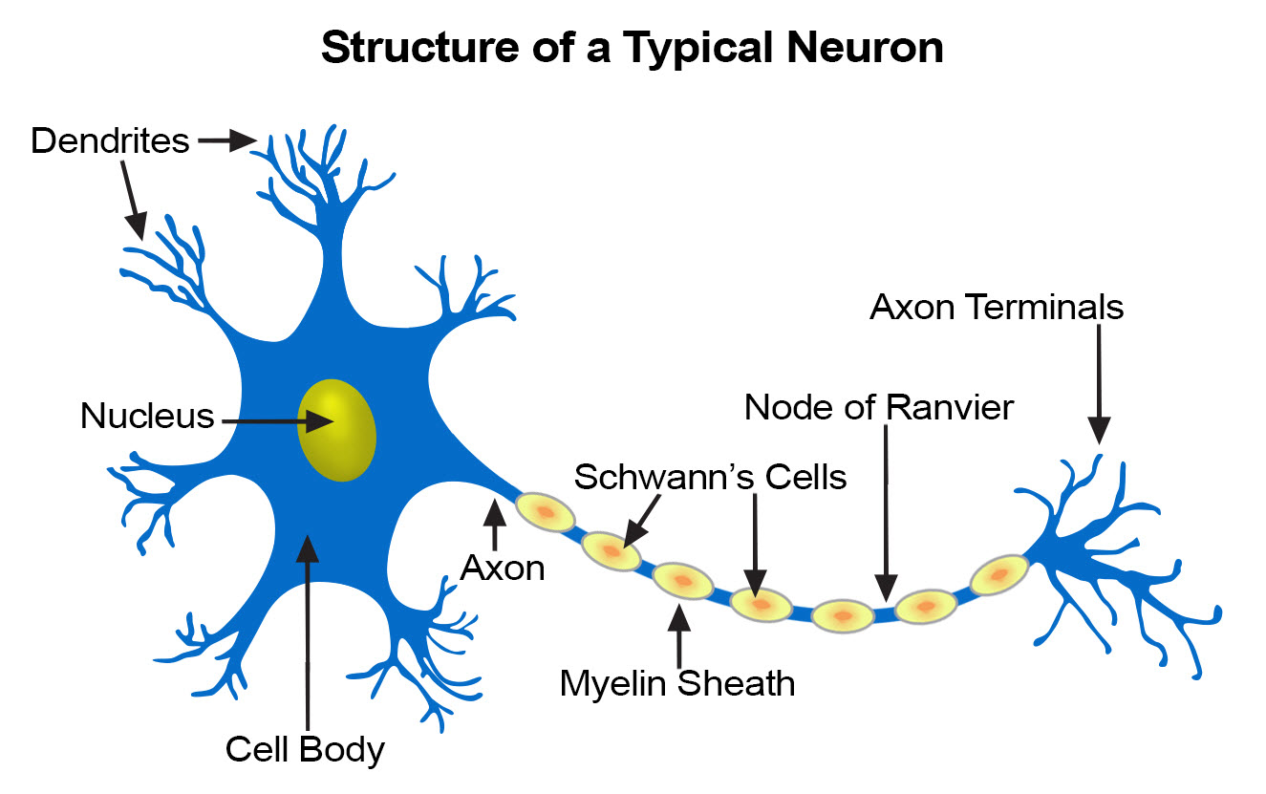
PERCEPTRON
Perceptrons are the simplest example of a neural network
The idea is to emulate a single neuron

Slide 51
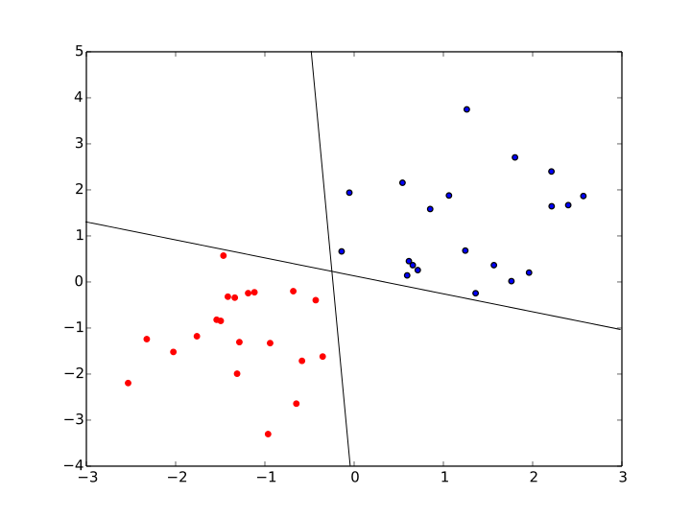
PERCEPTRON
Perceptrons are the simplest example of a neural network
Given n inputs and an activation or link function f
The perceptron computes a linear separating curve

Slide 52
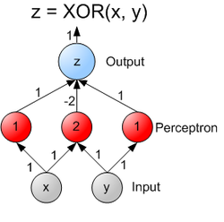
PERCEPTRON
Common activation functions are linear, logistic, tanh, and softmax
We’ll see shortly that some are better for classification, some for regression
Perceptrons can be combined into multilayer perceptrons or feed-forward network

Slide 53

FEED FORWARD NN
Source

Slide 54

FEED FORWARD NN
Source

Slide 55
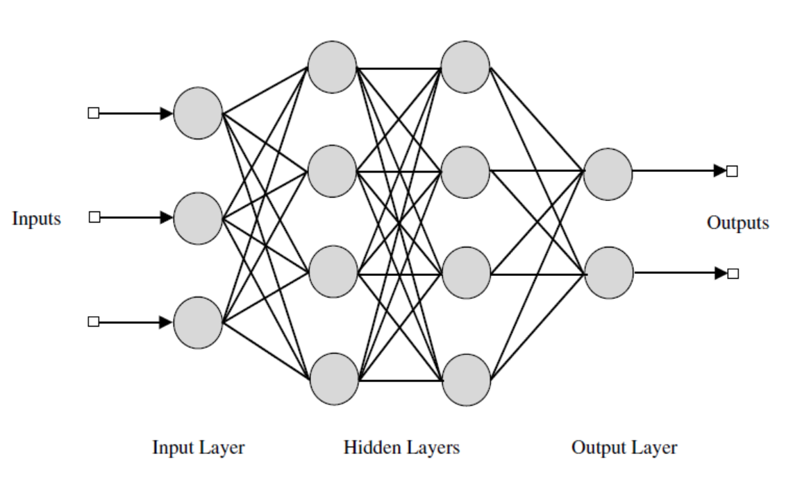
FEED FORWARD NN
Source

Slide 56
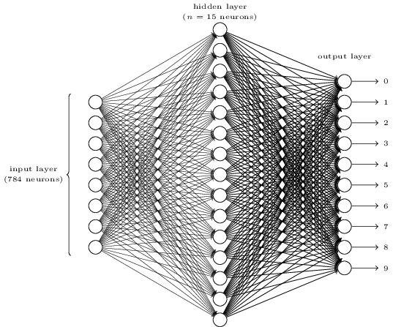
FEED FORWARD NN
Source

Slide 57
FEED FORWARD NN
Typically we use
Tanh or logistic layers for input
Linear layers for regression output
Logistic or Tanh for binary output
Softmax for n-class output (yields probabilities)

Slide 58
GUIDED PRACTICE
TRAINING

Slide 59
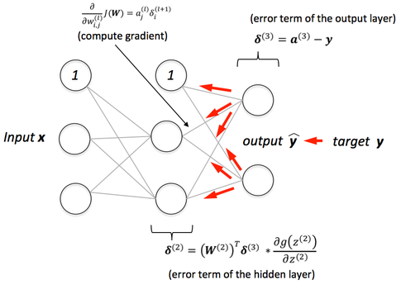
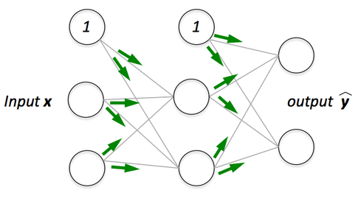
TRAINING
Feed forward neural networks can be trained with backpropagation
Source

Slide 60
TRAINING
Key Parameters
Learning Rate (gradient descent for training)
Epochs: number of backpropagation passes (over entire dataset)
Batch size: how many training points used at a time to update weights
Model others behaves as usual with
model.predict
model.predict_classes

Slide 61
TRAINING
Tips
If the error jumps around per epoch, decrease the learning rate
Taking too long to train: use higher learning rate or batch_size
High error after convergence?
More hidden layers / neurons
Normalize data or use PCA

Slide 62
INTRODUCTION
UNIVERSAL APPROXIMATION THEORY

Slide 63
UNIVERSAL APPROXIMATION
One major reason that neural networks are useful is the Universal Approximation Theorem
The result basically says that many real vector-valued functions can be approximated arbitrarily well with some feed-forward neural network
This is why neural networks are useful for regression -- given enough data and the right network structure they can fit many common data sets

Slide 64
CLASSIFICATION
CLASSIFICATION WITH NEURAL NETWORKS

Slide 65
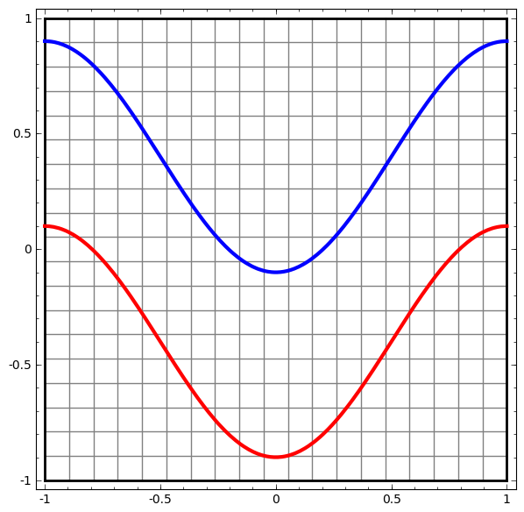
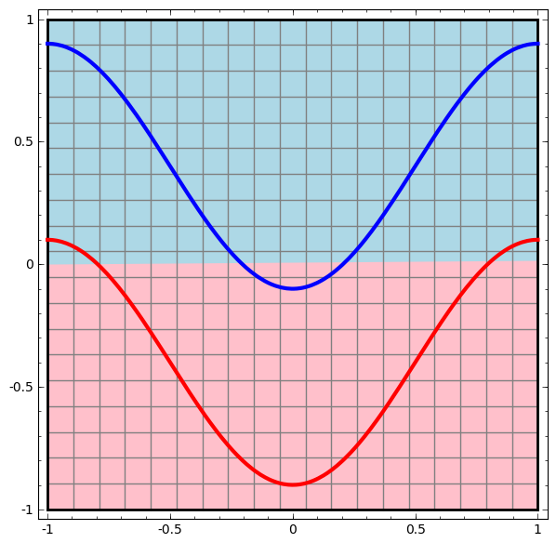
CLASSIFICATION
Neural Networks are also extremely useful for classification (source)
No hidden layers:

Slide 66
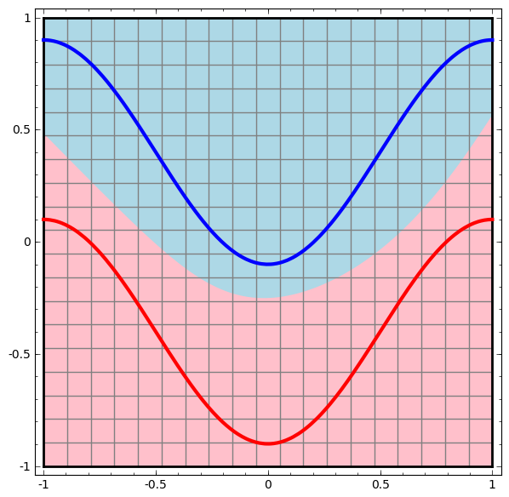
CLASSIFICATION
Neural Networks are also extremely useful for classification (source)
One hidden layer:

Slide 67
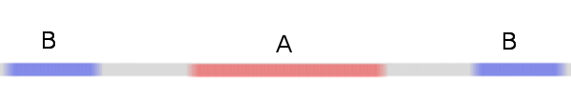
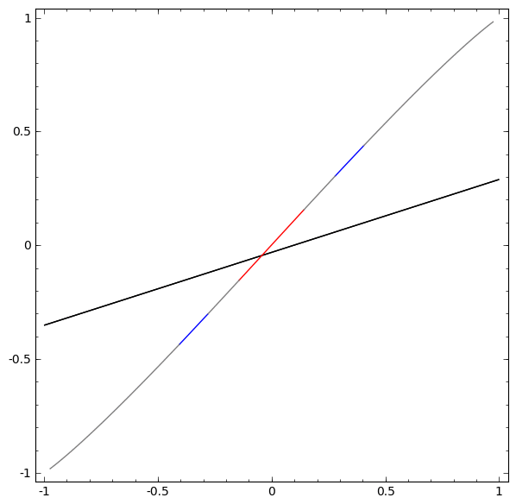
CLASSIFICATION
Neural Networks are also extremely useful for classification (source)

Slide 68
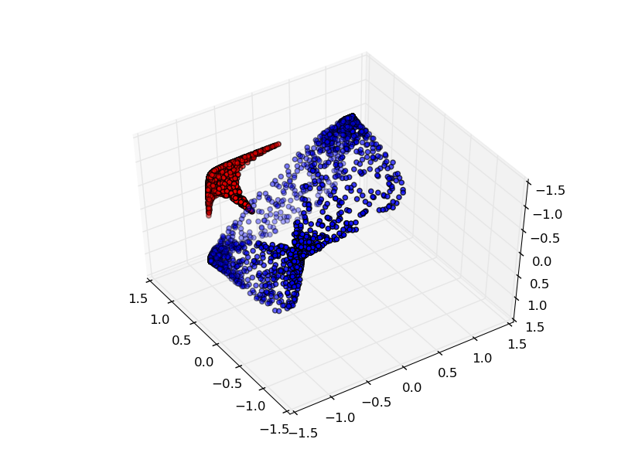
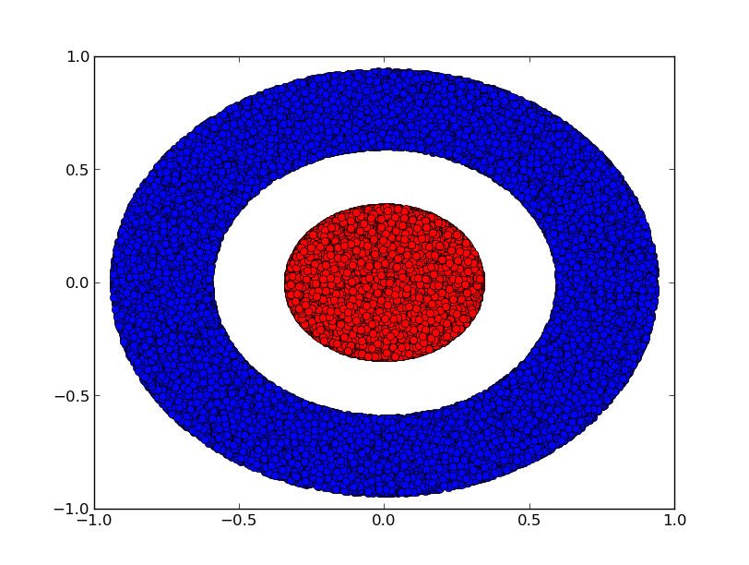
CLASSIFICATION
Neural Networks are also extremely useful for classification (source)

Slide 69
CLASSIFICATION
The neural network transforms the data topologically (no tears or breaks) and then separates the data with a hyperplane
NNs are capable of handling difficult data sets, including:
Image processing: recognizing hand-written characters
Image compression
Financial forecasting
Many others

Slide 70

ACTIVITY: KNOWLEDGE CHECK
Let’s practice using neural networks for classification. For each of the four datasets, experiment with the number of layers and neurons to find the best model
Also take a look at this visualization
ANSWER THE FOLLOWING QUESTIONS
EXERCISE
DELIVERABLE
Answers to the above questions

Slide 71
GUIDED PRACTICE
NEURAL NETWORKS IN PYTHON

Slide 72
NN IN PYTHON
There are many NN libraries for python and other languages
Python
Theano
Lasagne
TensorFlow
Scikit Learn
Keras: A high-level neural networks API, written in Python and capable of running on top of TensorFlow, CNTK, or Theano. It was developed with a focus on enabling fast experimentation
Lua
Torch
Some of these libraries utilize GPUs for (much) faster training

Slide 73
NN IN PYTHON
Let’s look at some examples in Keras
Regression
Classification

Slide 74
GUIDED PRACTICE
DESIGNING NEURAL NETWORKS

Slide 75
NN IN PYTHON
Network design is a hard problem
Experience helps
Evolutionary algorithms are useful for design
Nice (free) book available

Slide 76
RECCURENT NN
RECURRENT NEURAL NETWORKS

Slide 77
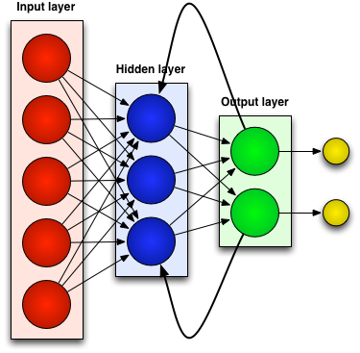
RECURRENT NEURAL NETWORKS
Recurrent Neural Networks contain loops (source)

Slide 78
RECURRENT NEURAL NETWORKS
Recurrent Neural Networks contain loops
This implements feedback and gives neural networks “memory” or context
Particularly good for predicting sequences, translating text, recognizing objects in images, speech translation
Commonly referred to as deep learning, involving both feature extraction and modeling
Nice intro here

Slide 79
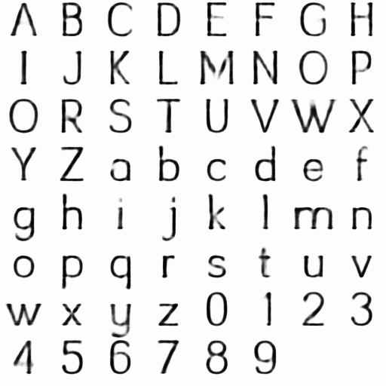
RECURRENT NEURAL NETWORKS
RNN font analysis

Slide 80
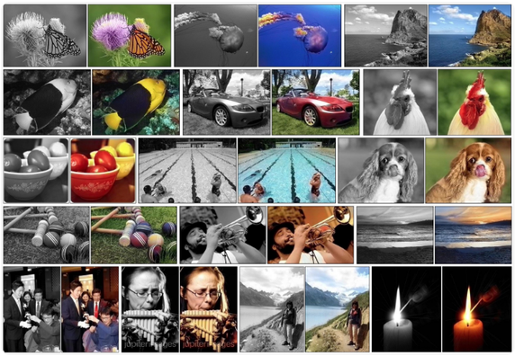
RECURRENT NEURAL NETWORKS
Automatic Colorization with CNN

Slide 81
RECURRENT NEURAL NETWORKS
RNN font analysis
Automatic Colorization with CNN
Automatic translation
Deep Learning Applications

Slide 82
CONCLUSION
THINGS TO NOTE

Slide 83
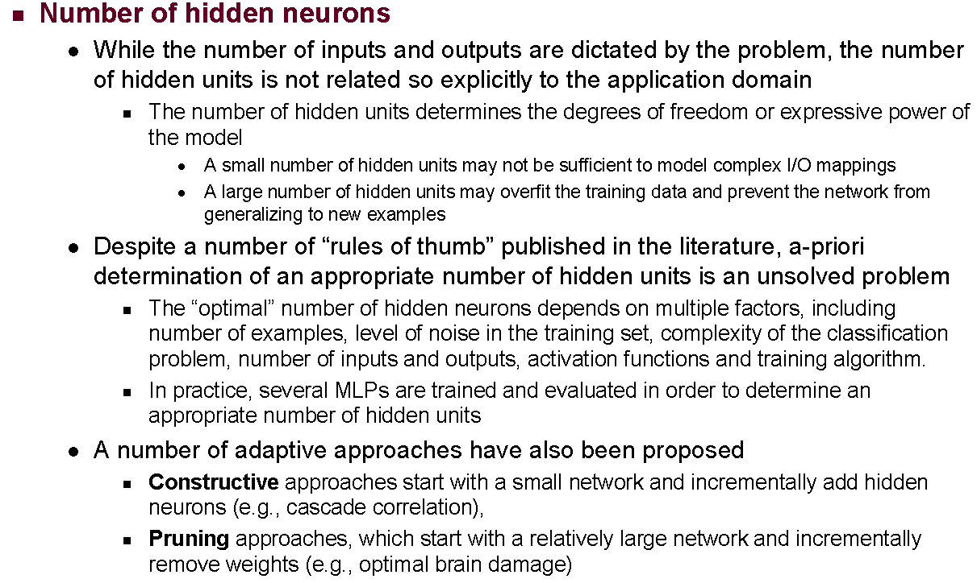
NEURAL NETWORKS: CONCERNS

Slide 84
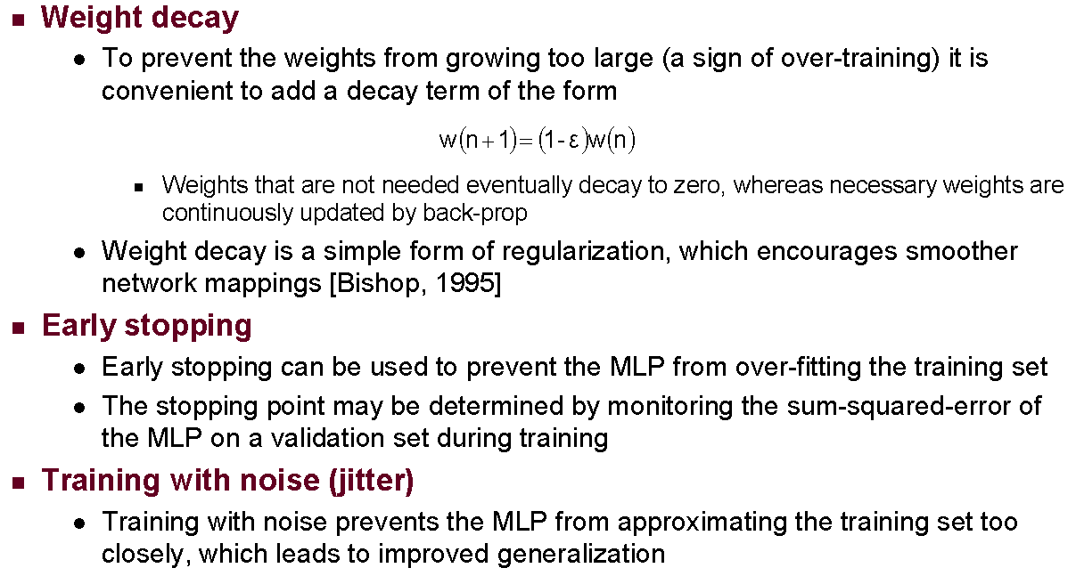
NEURAL NETWORKS: CONCERNS

Slide 85
CONCLUSION
TOPIC REVIEW

Slide 86
CONCLUSION: Neural Networks
Pros:
Flexible
Good for a variety of tasks
Good for many types of data
Cons:
Can require a lot of data
Training may be slow
Many parameters to tune
Many layer types and activations
Black Box model

Slide 87
CONCLUSION
Many more examples for Keras available
Recommended articles: Convolutional NN,
Advanced machine learning methods you should explore include Bayesian methods and deep learning

Slide 88
COURSE
BEFORE NEXT CLASS

Slide 89
DUE DATE
BEFORE NEXT CLASS
Project: Final Project, Part 5!!

Slide 90
LESSON
Q & A

Slide 91
LESSON
EXIT TICKET
DON’T FORGET TO FILL OUT YOUR EXIT TICKET

